Slide 1
Computer vision for video (Motion analysis)
Translational alignment
Optical flow

Slide 2
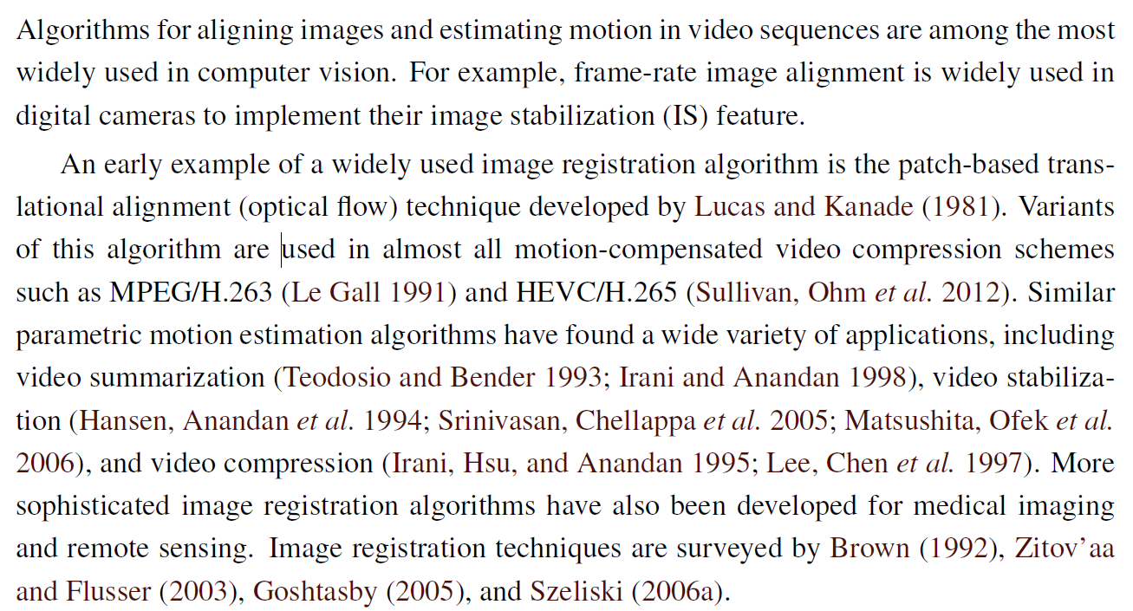
Motion analysis

Slide 3
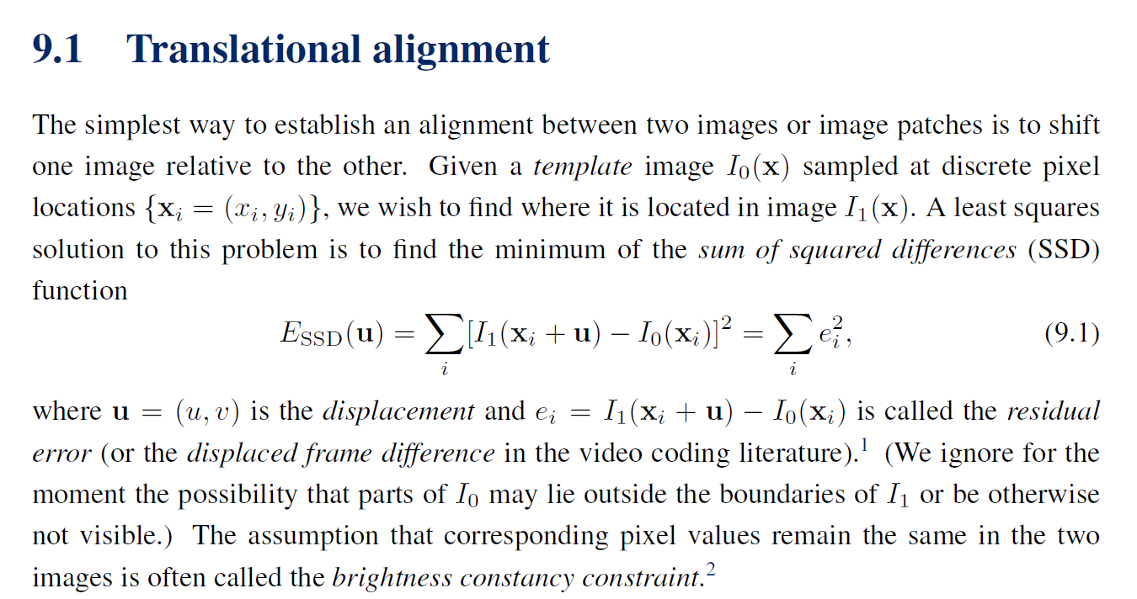

Slide 4
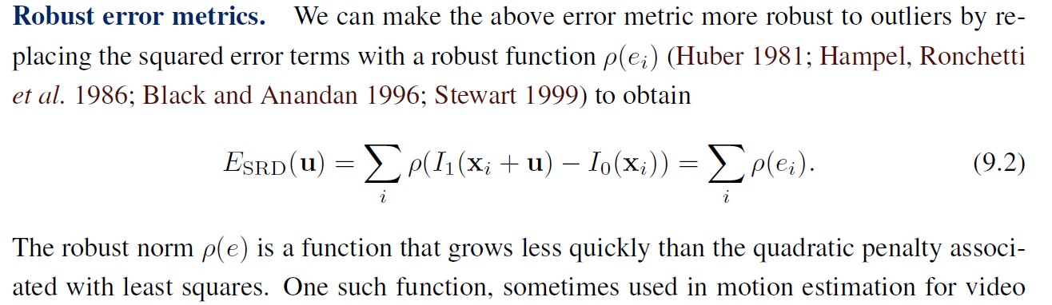
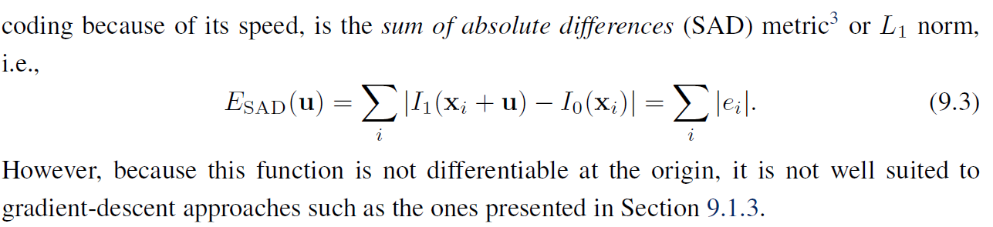

Slide 5
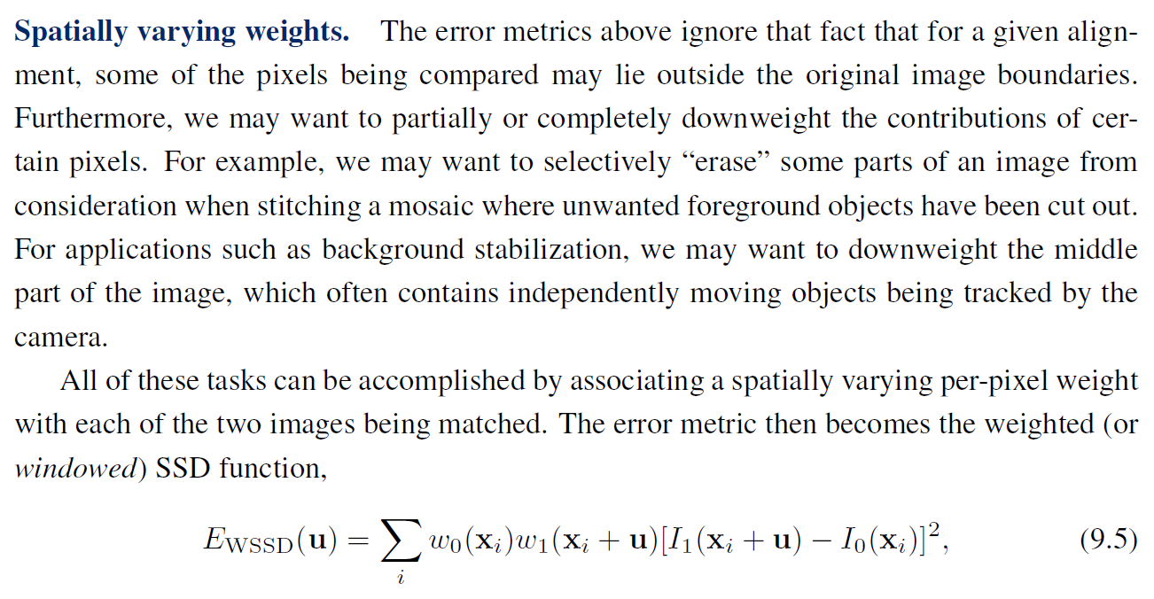

Slide 6
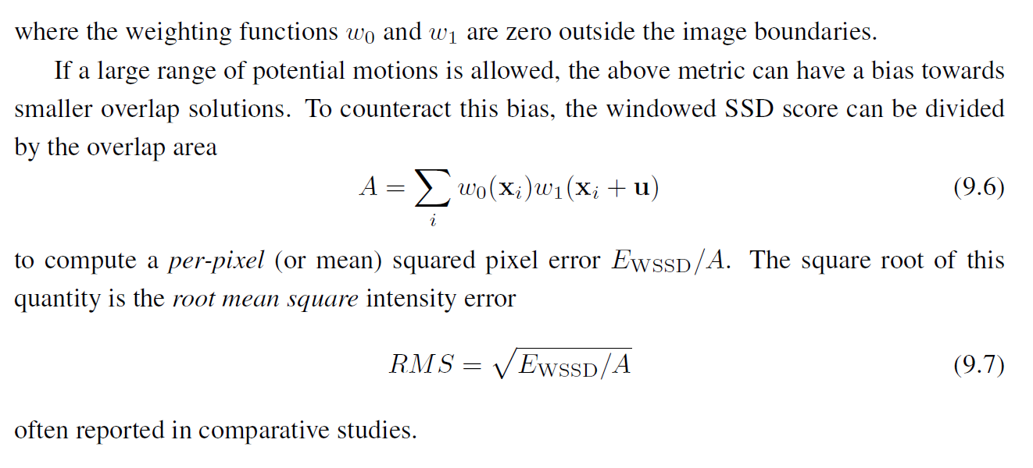

Slide 7
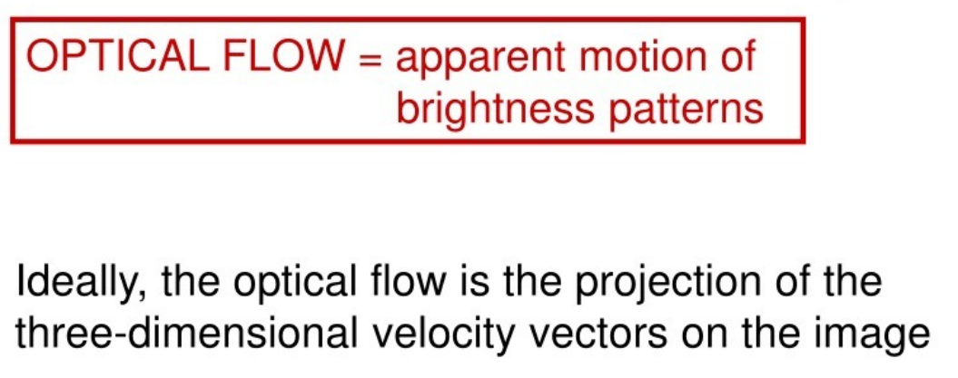
Optical Flow
The most general (and challenging) version of motion estimation is to compute an independent estimate of motion at each pixel, which is generally known as optical (or optic) flow.

Slide 8
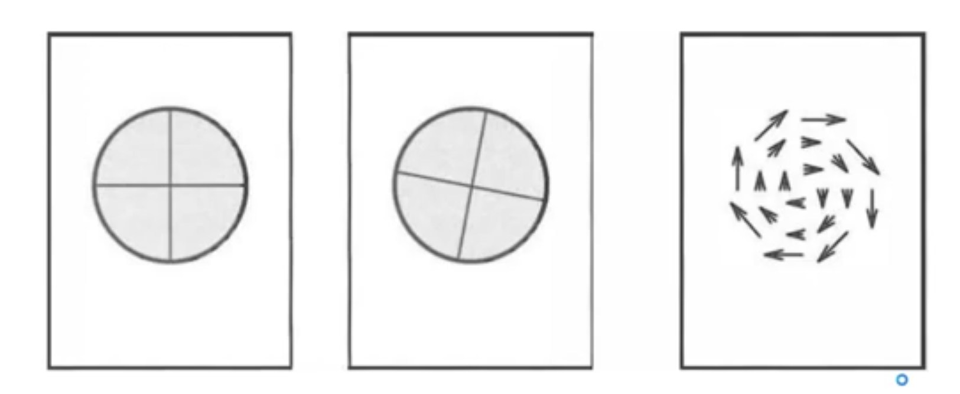
Basic idea
Optical Flow

Slide 9
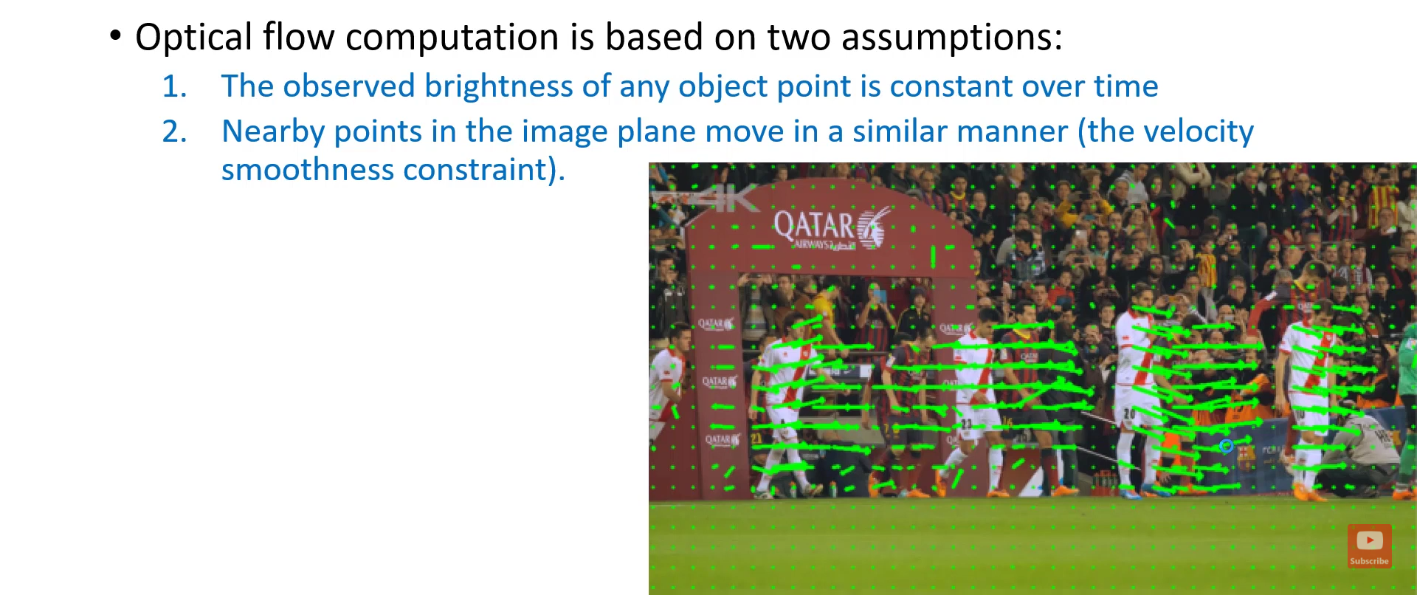
Basic idea

Slide 10
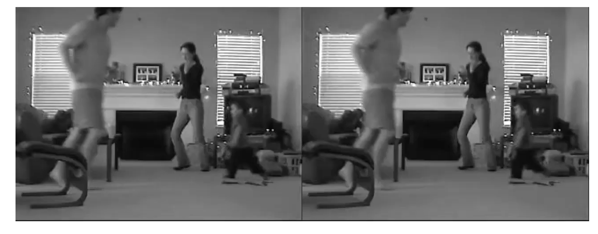
Basic idea

Slide 11
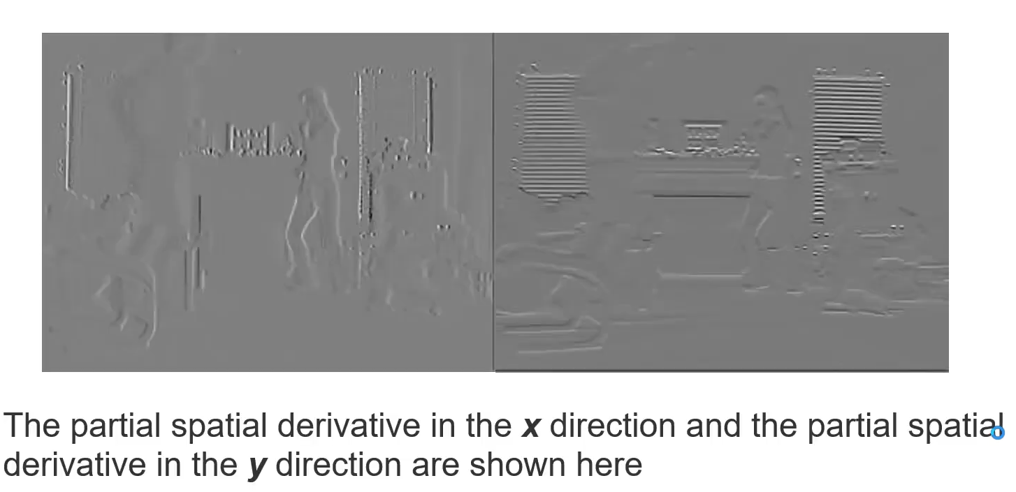
Basic idea

Slide 12
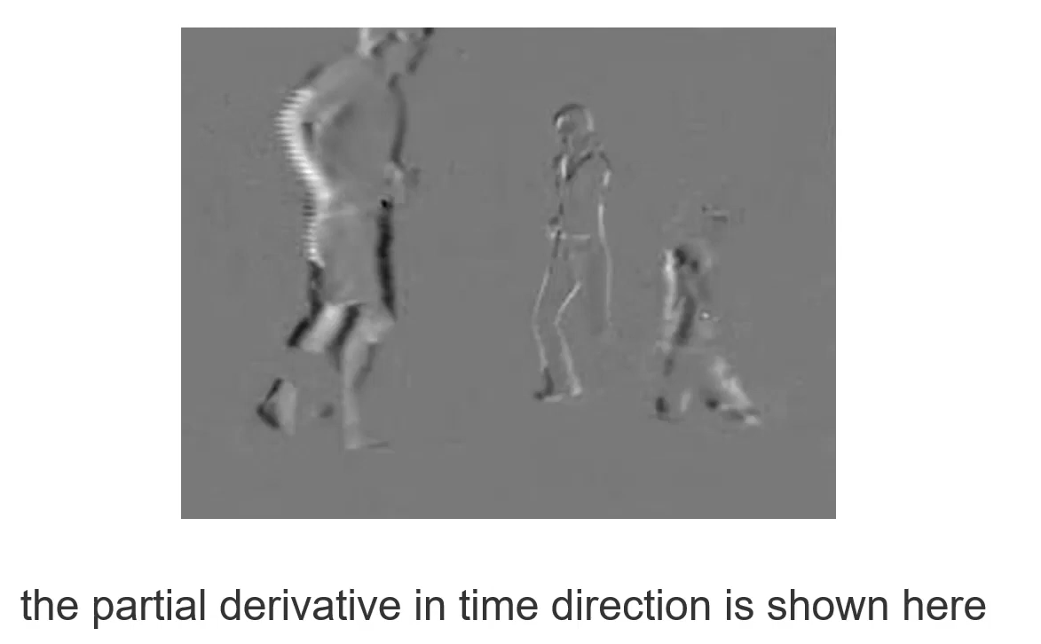
Basic idea

Slide 13
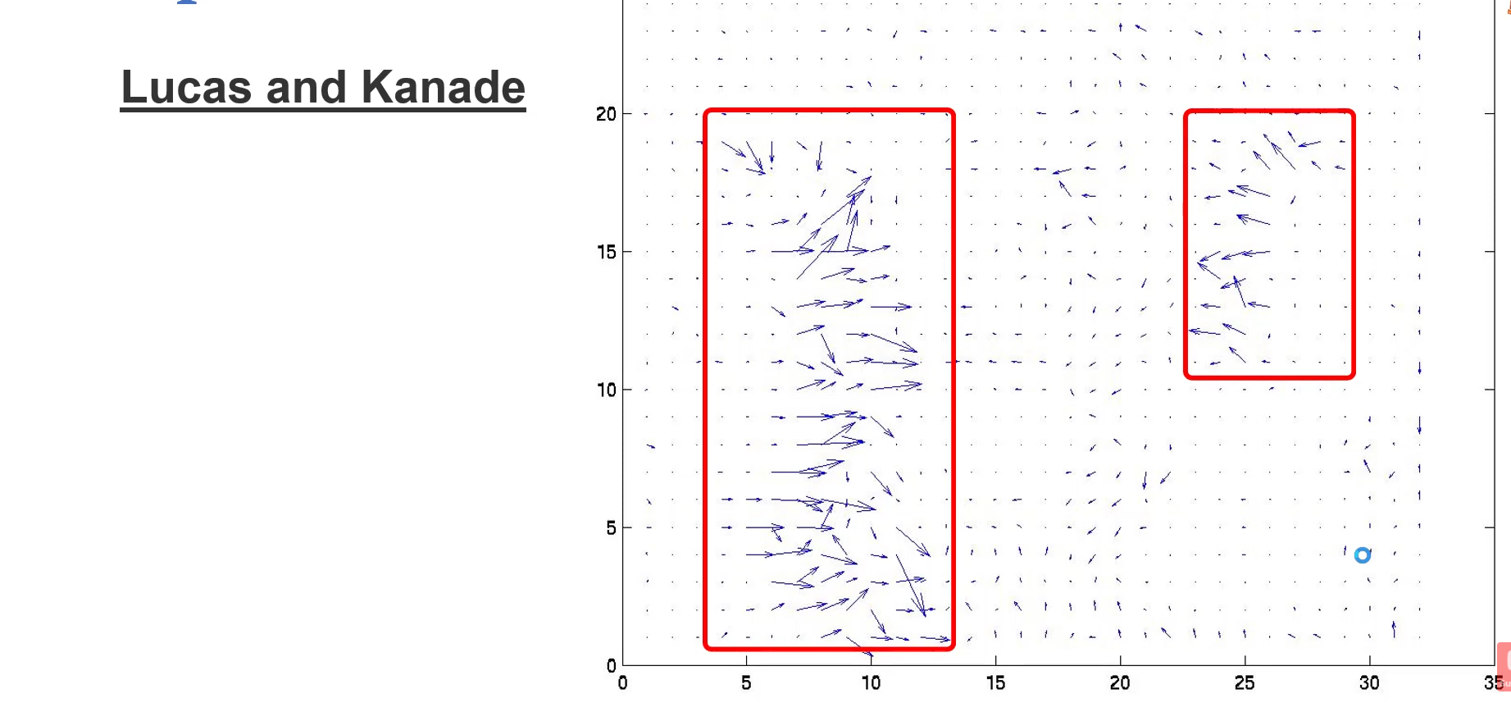
Basic idea

Slide 14
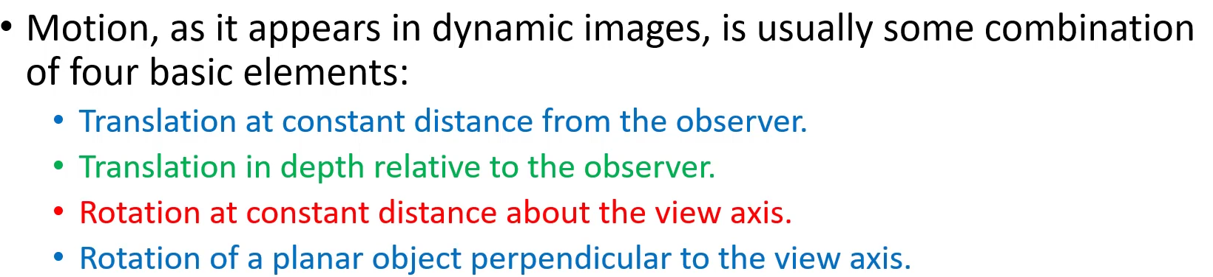


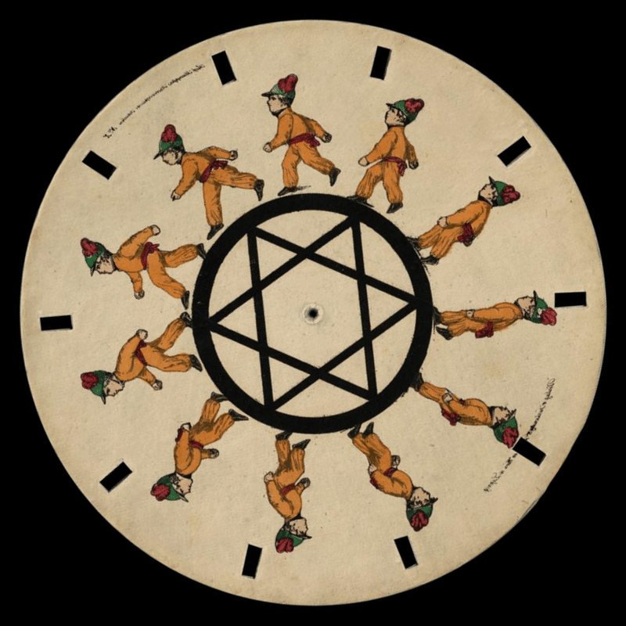
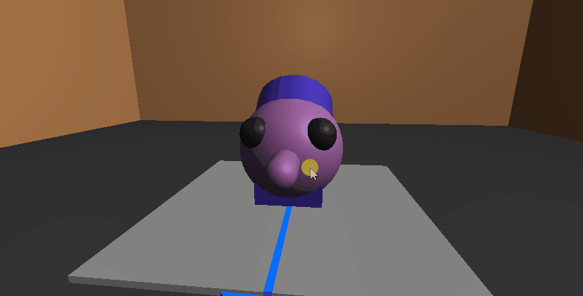
Basic idea

Slide 15
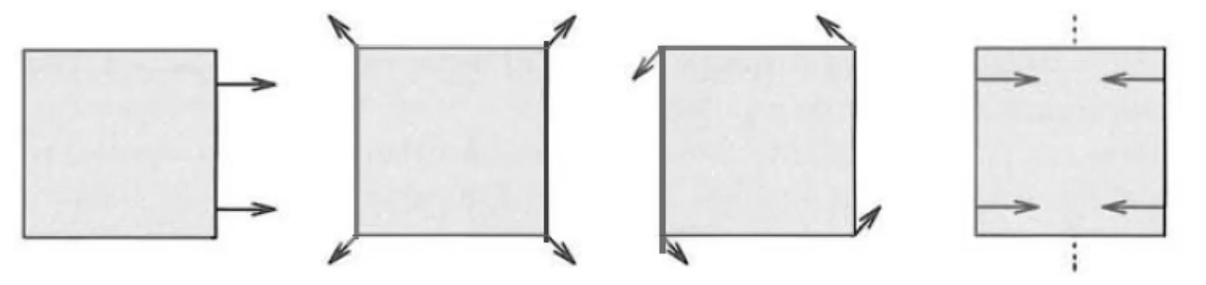
Basic idea

Slide 16
Planer motion example

Slide 17
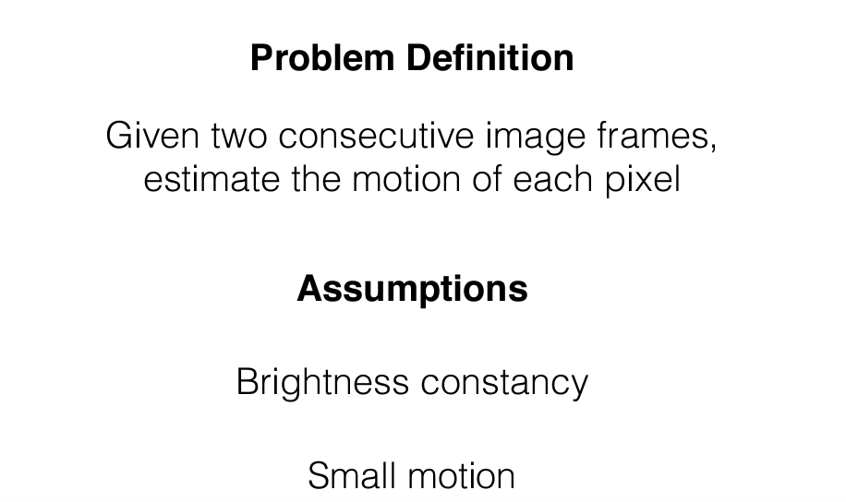
Optical Flow

Slide 18
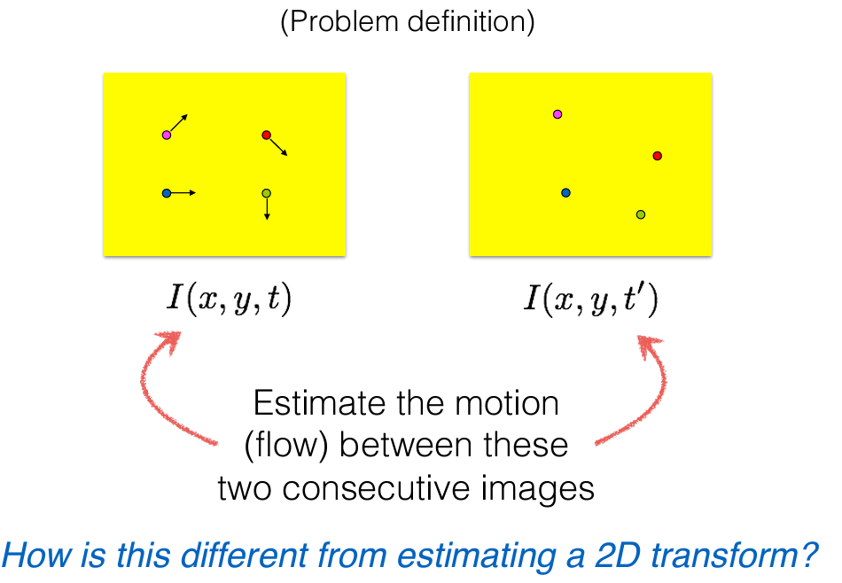
Optical Flow

Slide 19
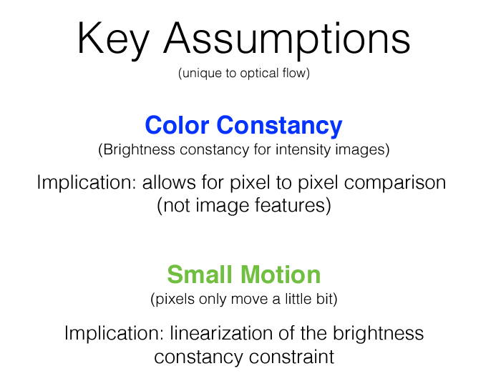
Optical Flow

Slide 20
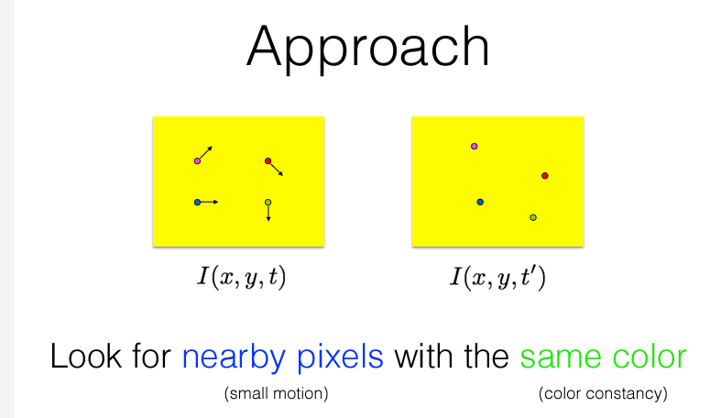
Optical Flow

Slide 21
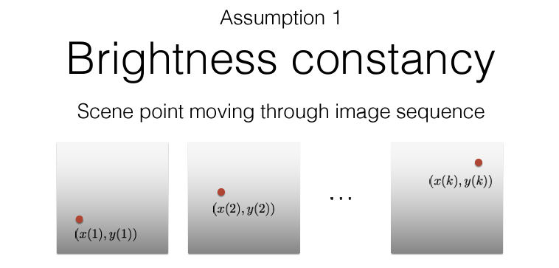
Optical Flow

Slide 22
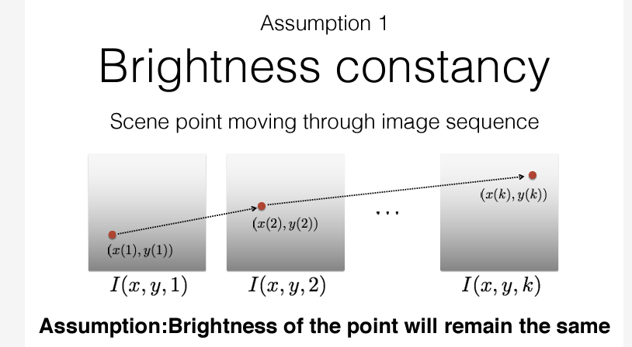
Optical Flow

Slide 23
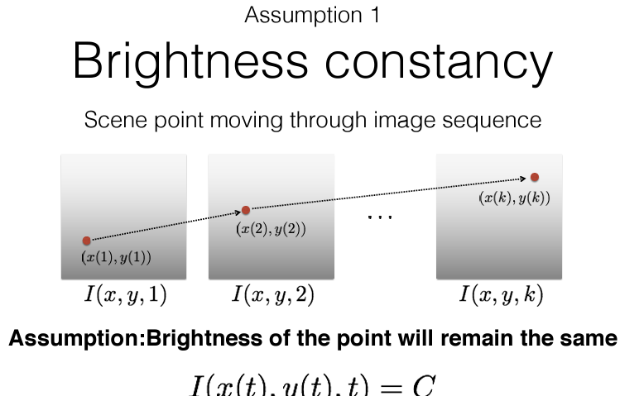
Optical Flow

Slide 24
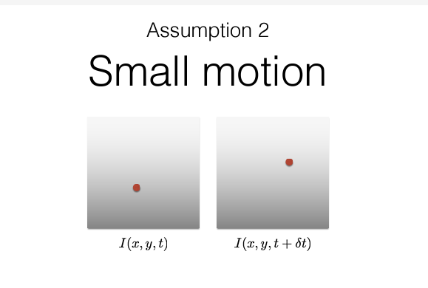
Optical Flow

Slide 25
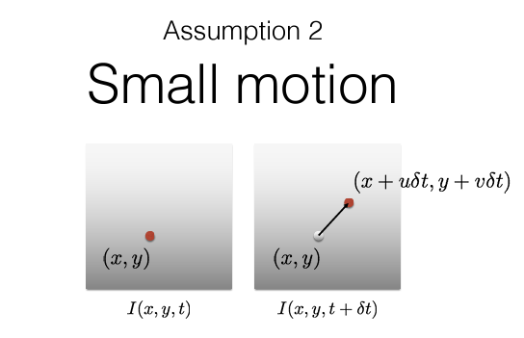
Optical Flow

Slide 26
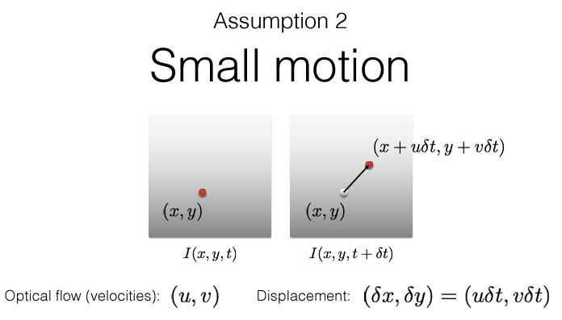
Optical Flow

Slide 27
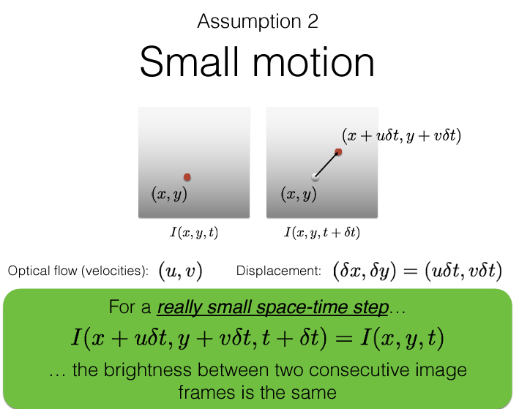
Optical Flow

Slide 28
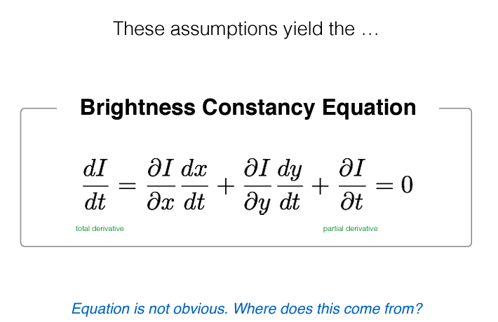

Slide 29
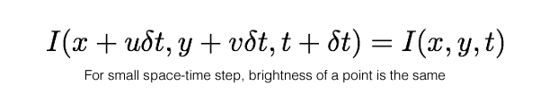
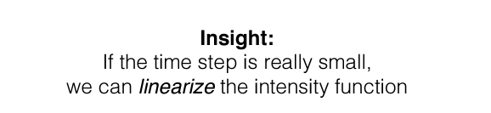

Slide 30
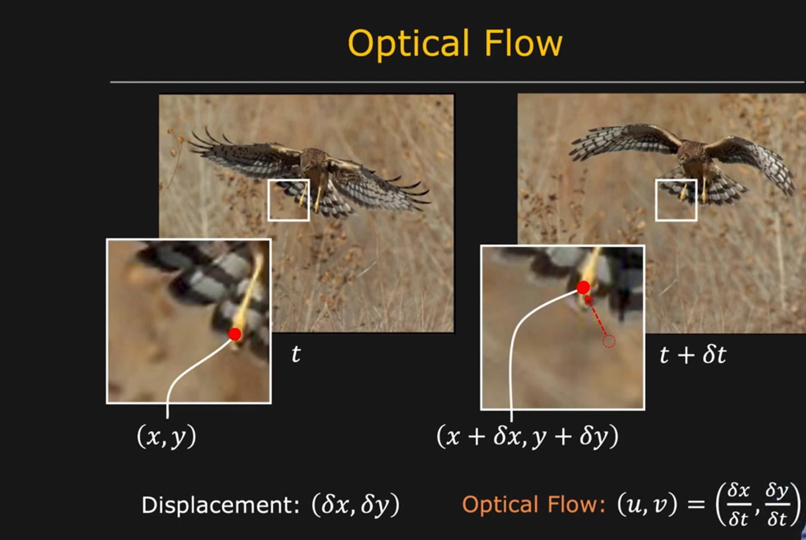

Slide 31
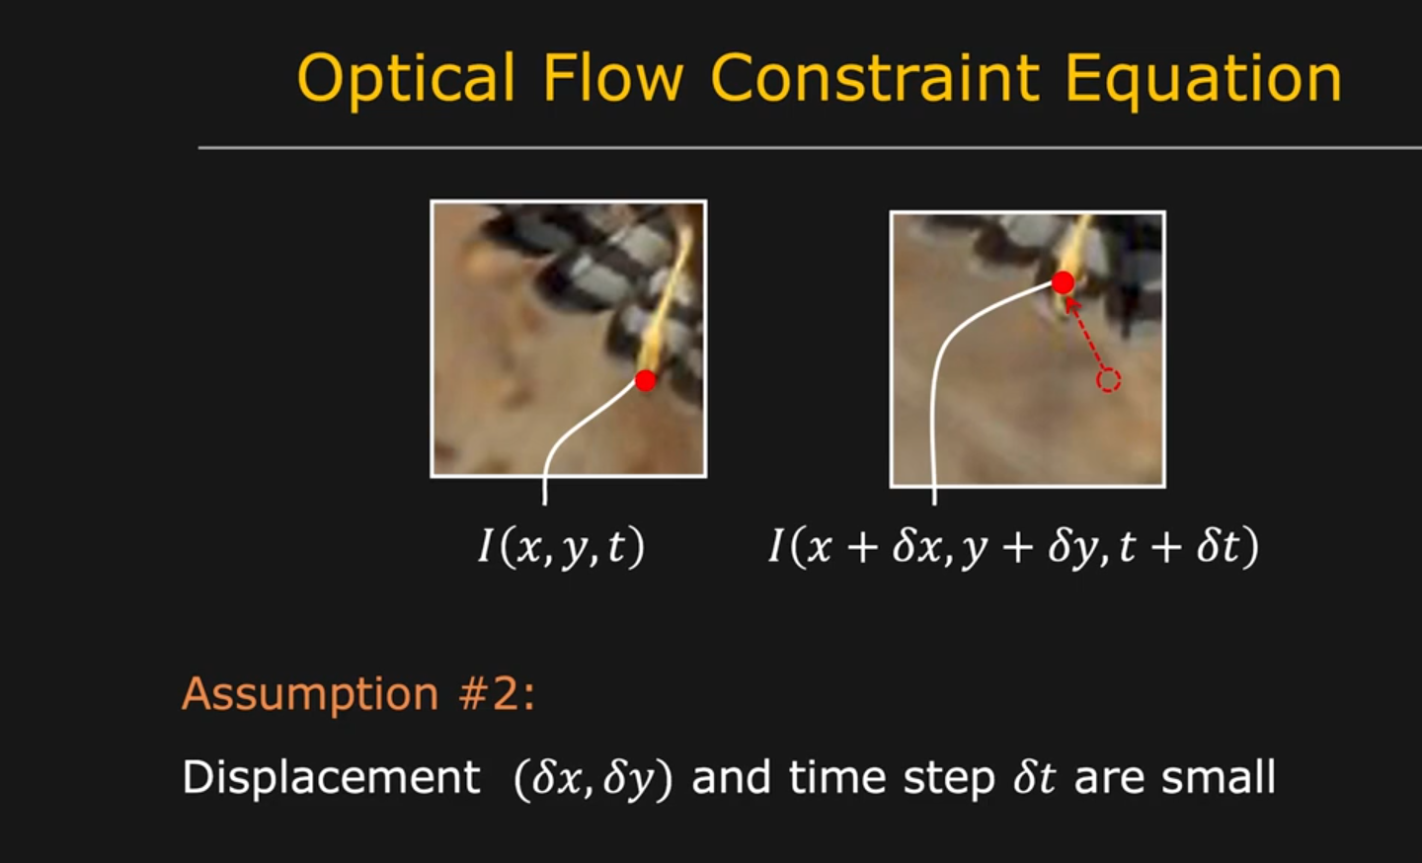

Slide 32
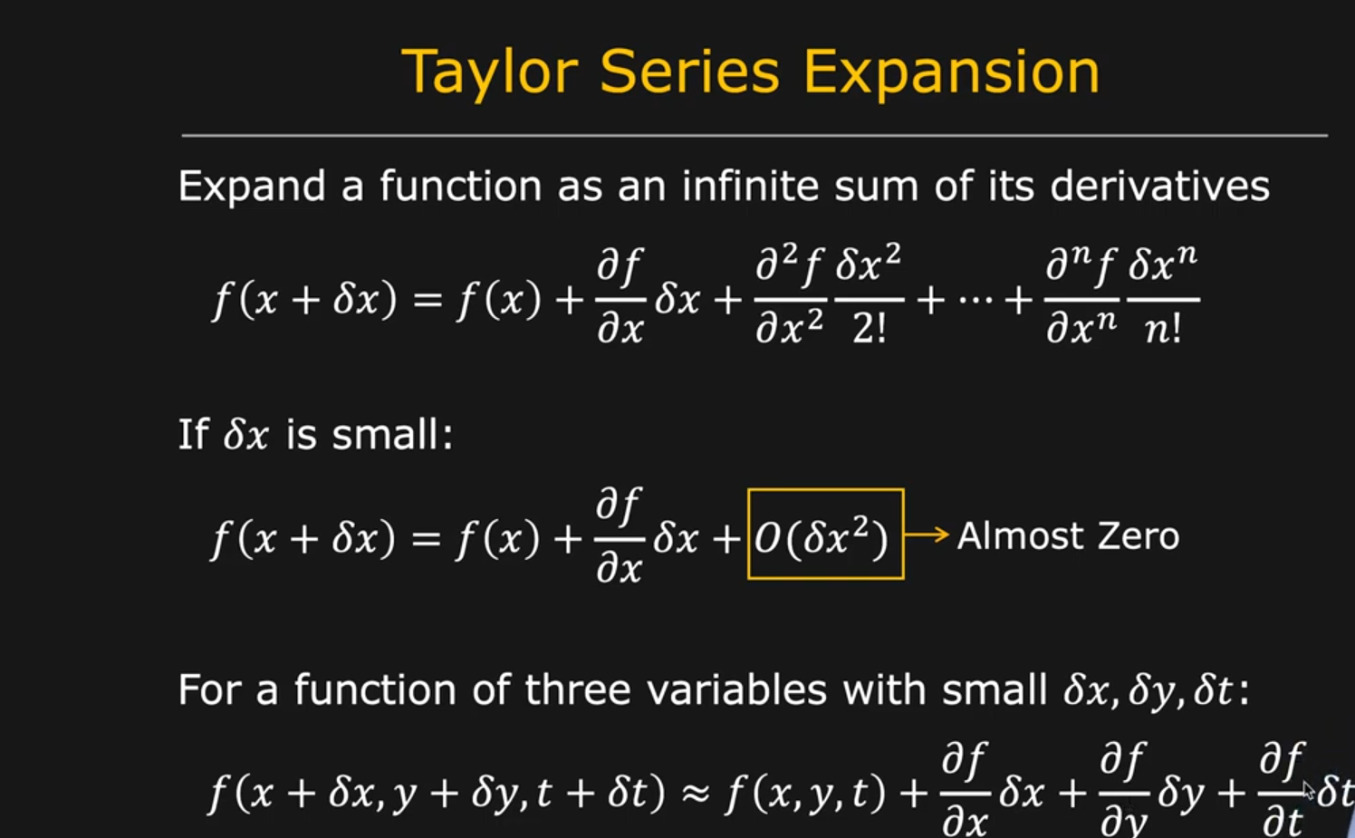

Slide 33
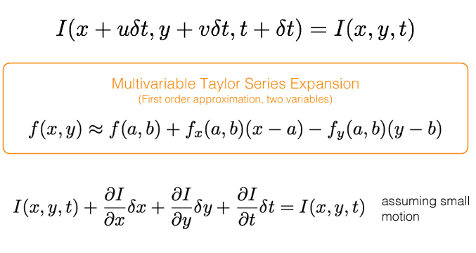

Slide 34
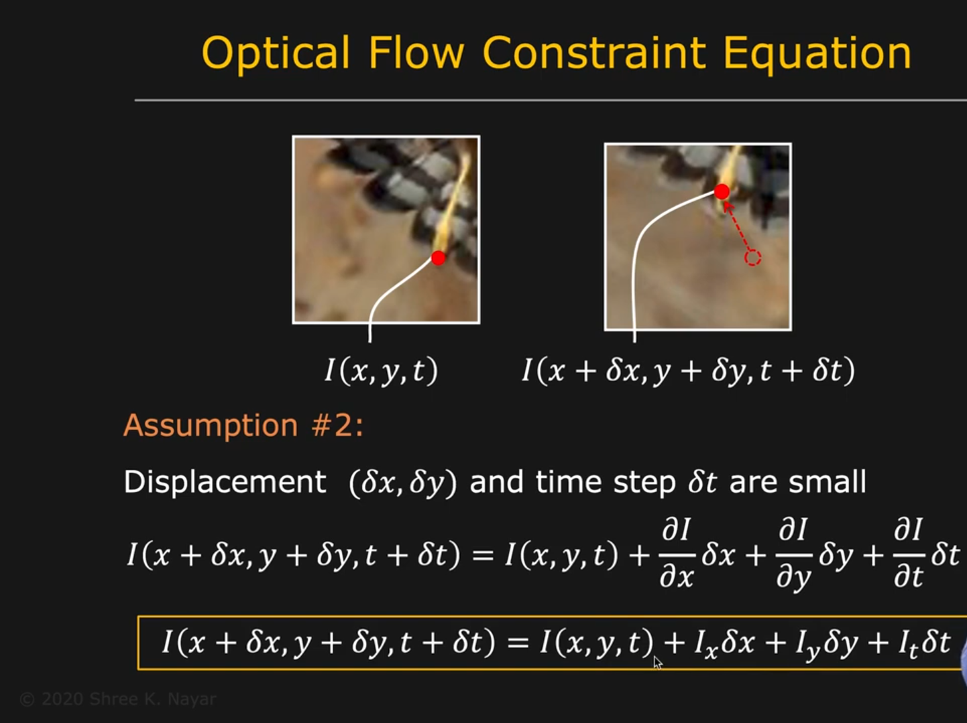

Slide 35
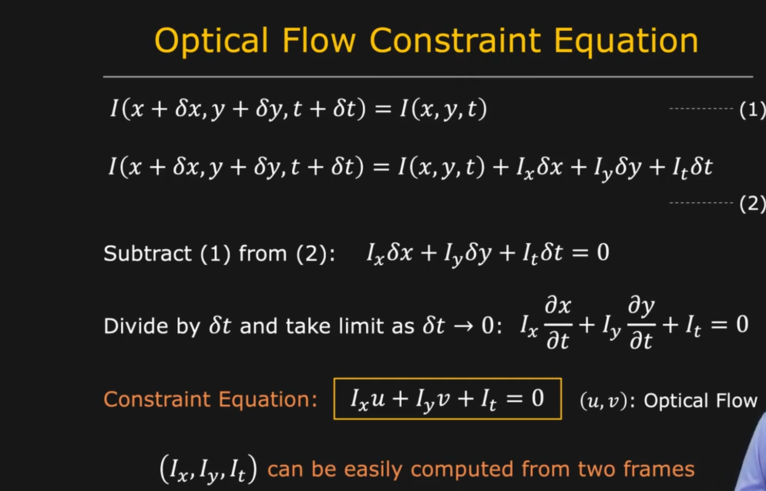
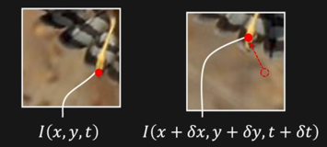

Slide 36
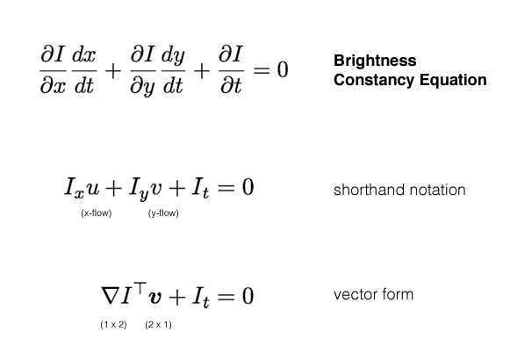

Slide 37
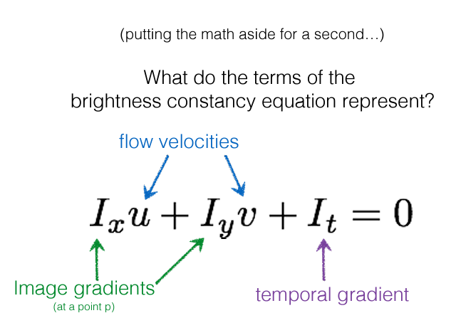

Slide 38
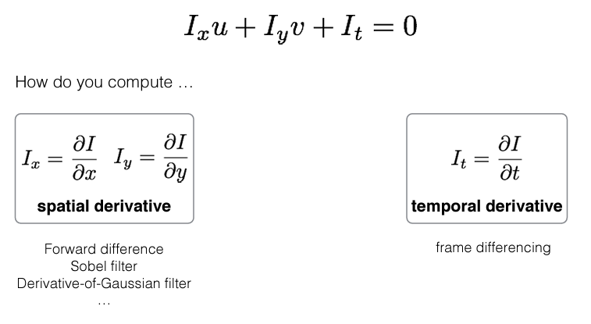

Slide 39
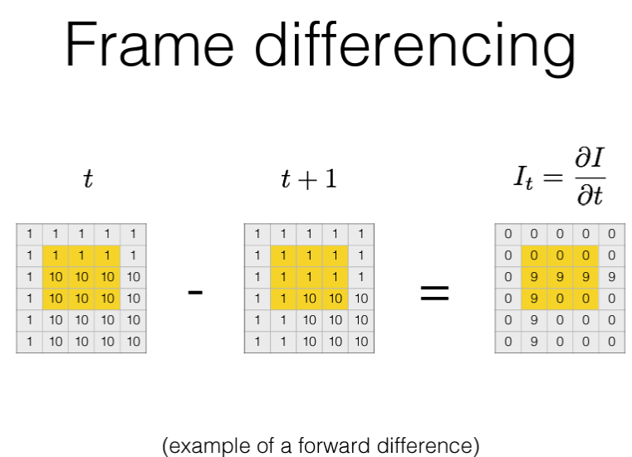

Slide 40
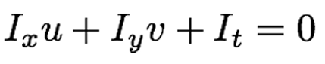
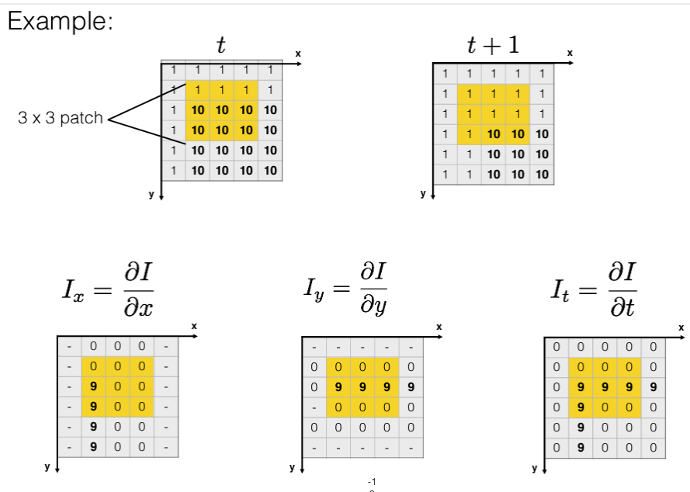

Slide 41
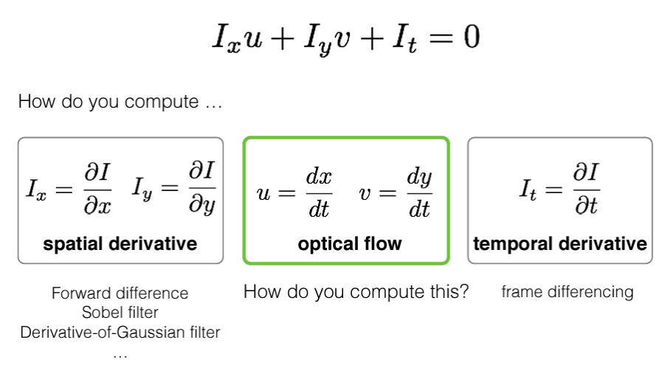

Slide 42
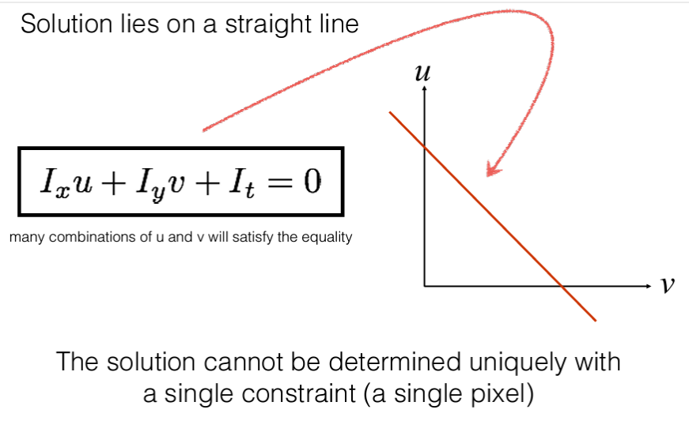

Slide 43
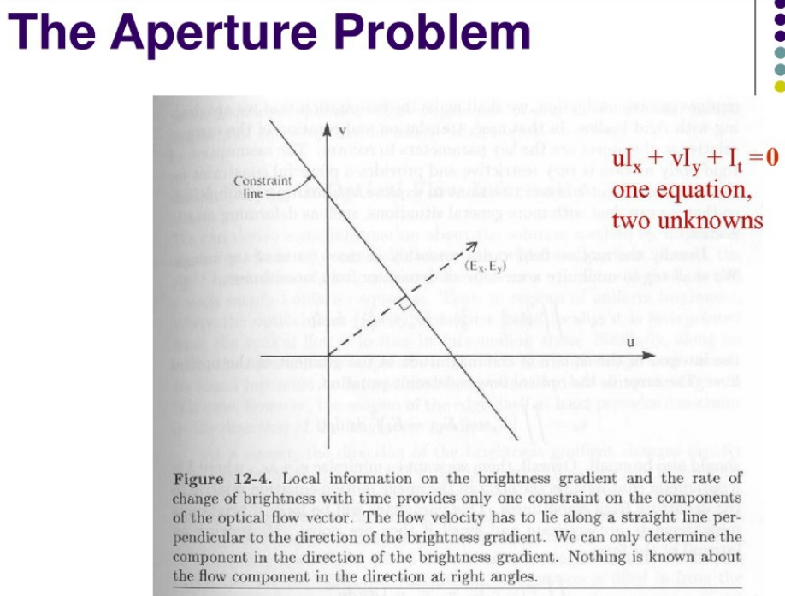

Slide 44
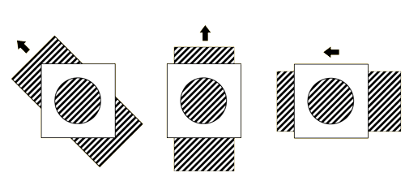
Aperture problem and normal flow

Slide 45
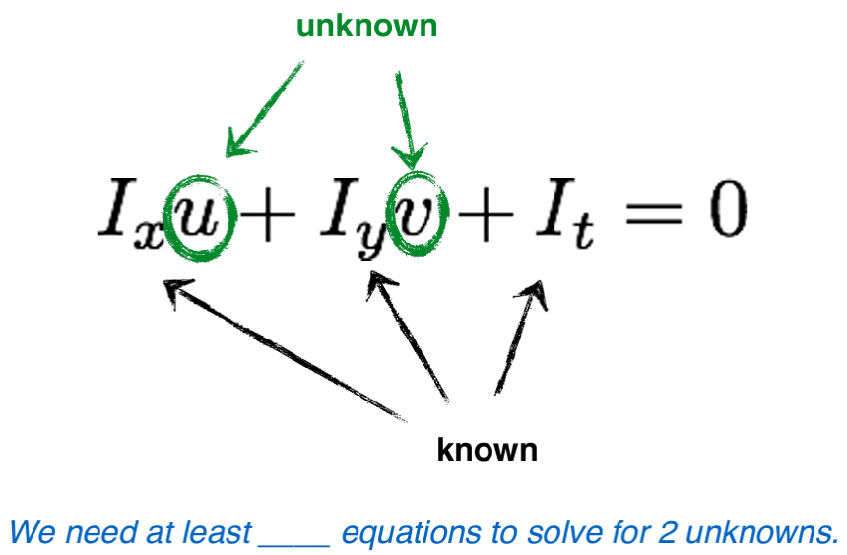

Slide 46
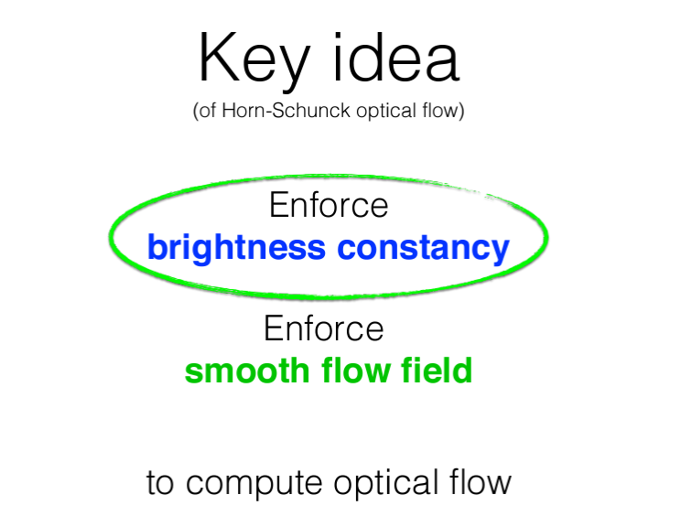

Slide 47


Slide 48


Slide 49


Slide 50
Q&A

Slide 51

Quiz 03 (CLO 3) (10 marks)
Q1; How to obtain 3D information for a computer vision based application? Elaborate challenges to contrast the geometric relationships between 2D images and the 3D world. (5 marks)
Q2; In the given scenario, how we can derive
3D data using single camera and
a structured light source . (5 marks)
3D point
(10, 20, 30)
θ=
(0,0,0)
b
[x y z] = --------------- [x´ y´ f]
f cot θ - x´
light
source
15
x axis
f
(x´,y´,10)

